Slide 1
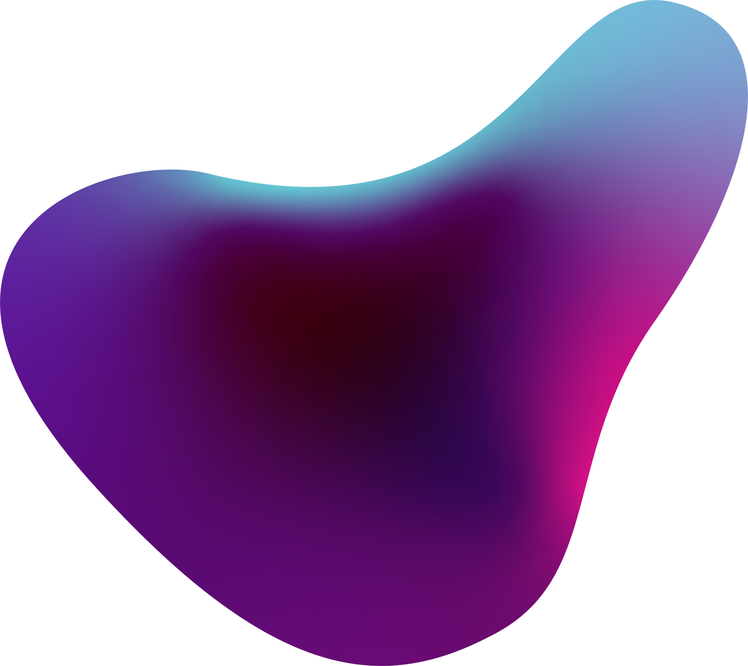
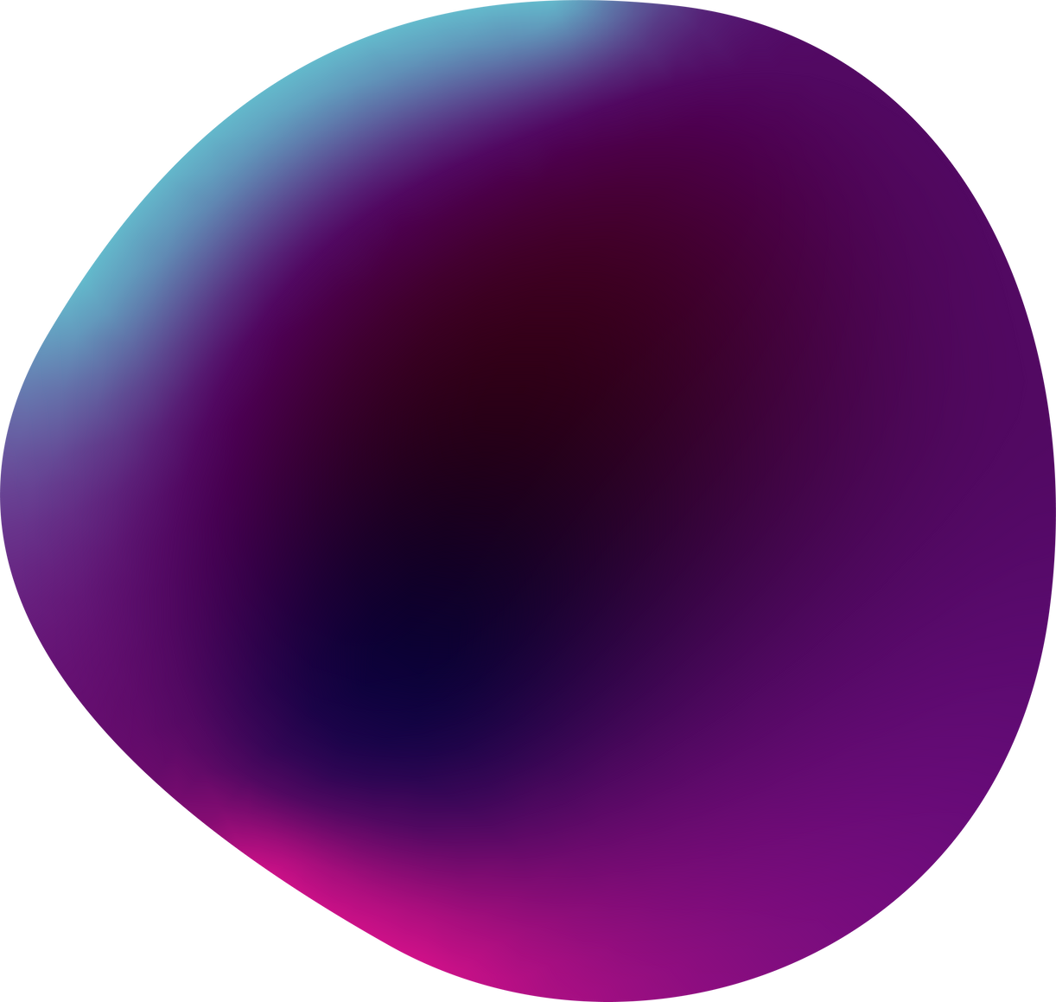
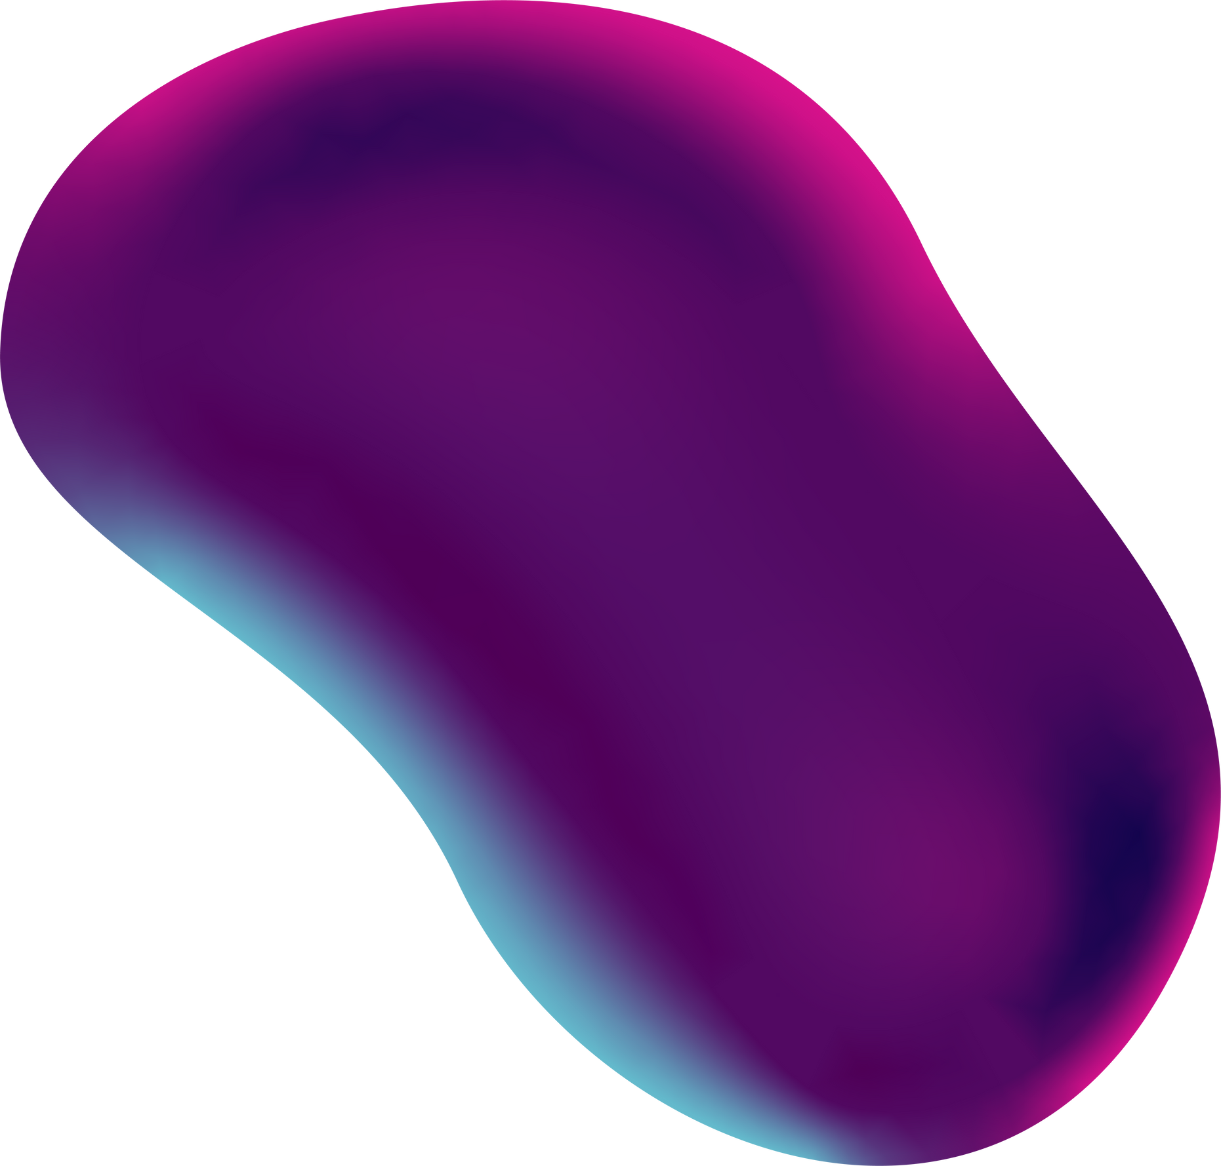
NTU chatbot
chatbot for university process

Slide 2
Our Team
02
Waleed Iqbal
Huzaifa Umer
Aman Majeed

Slide 3
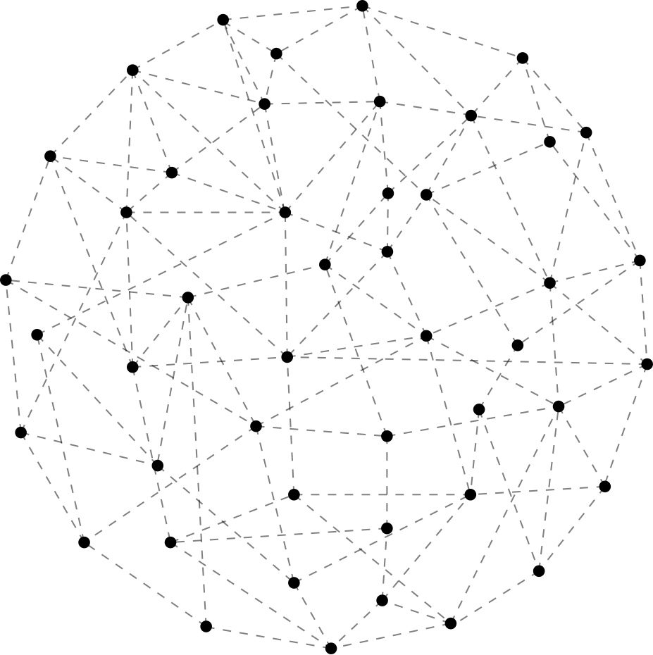
Table of Content
NLP(Natural Language processing)
Neural Networks
Flask Framework(python)
libraries (tensorflow,nlpk,keras)
dataset
conclusion

Slide 4
Flask application sets up a web server that provides a chatbot interface. Users can interact with the chatbot by entering text input, and the application will generate appropriate responses using the chatbot_response() function. The interface is rendered using HTML templates, with CSS and JavaScript files stored in the 'static' folder.
Flask Framework

Slide 5
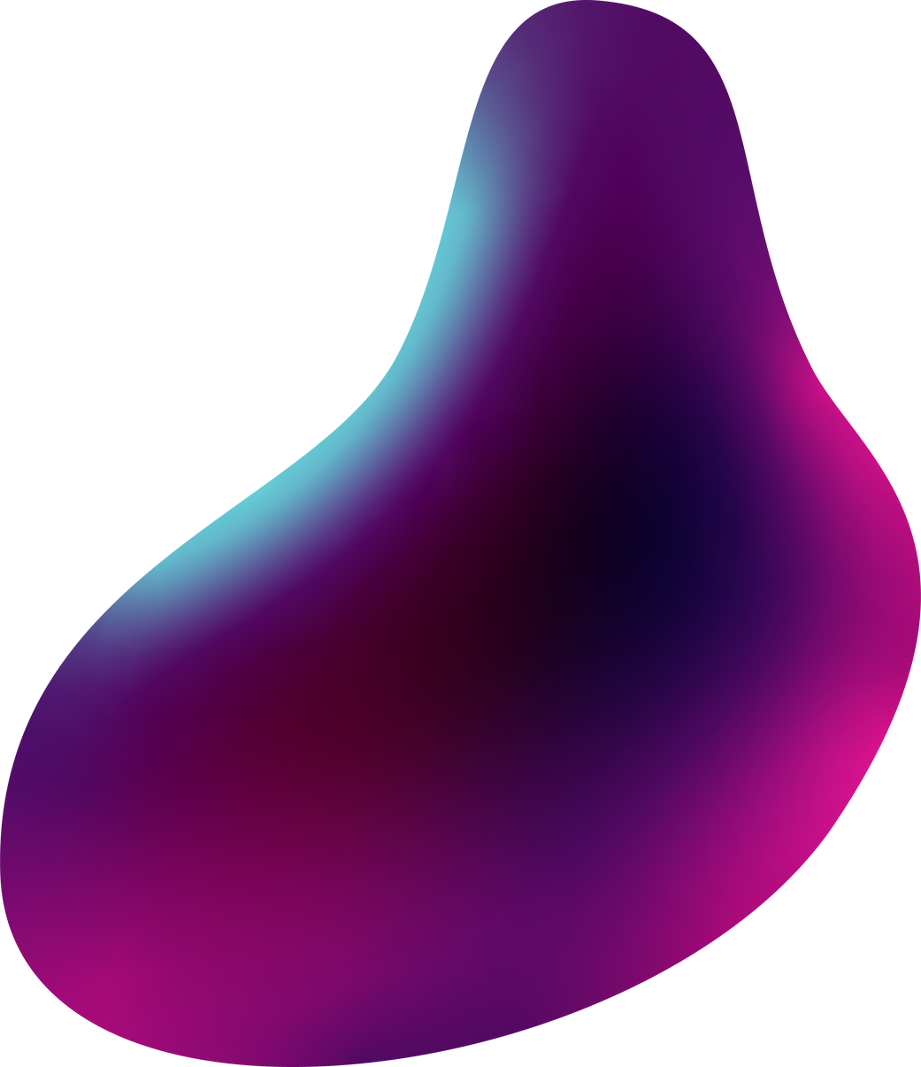
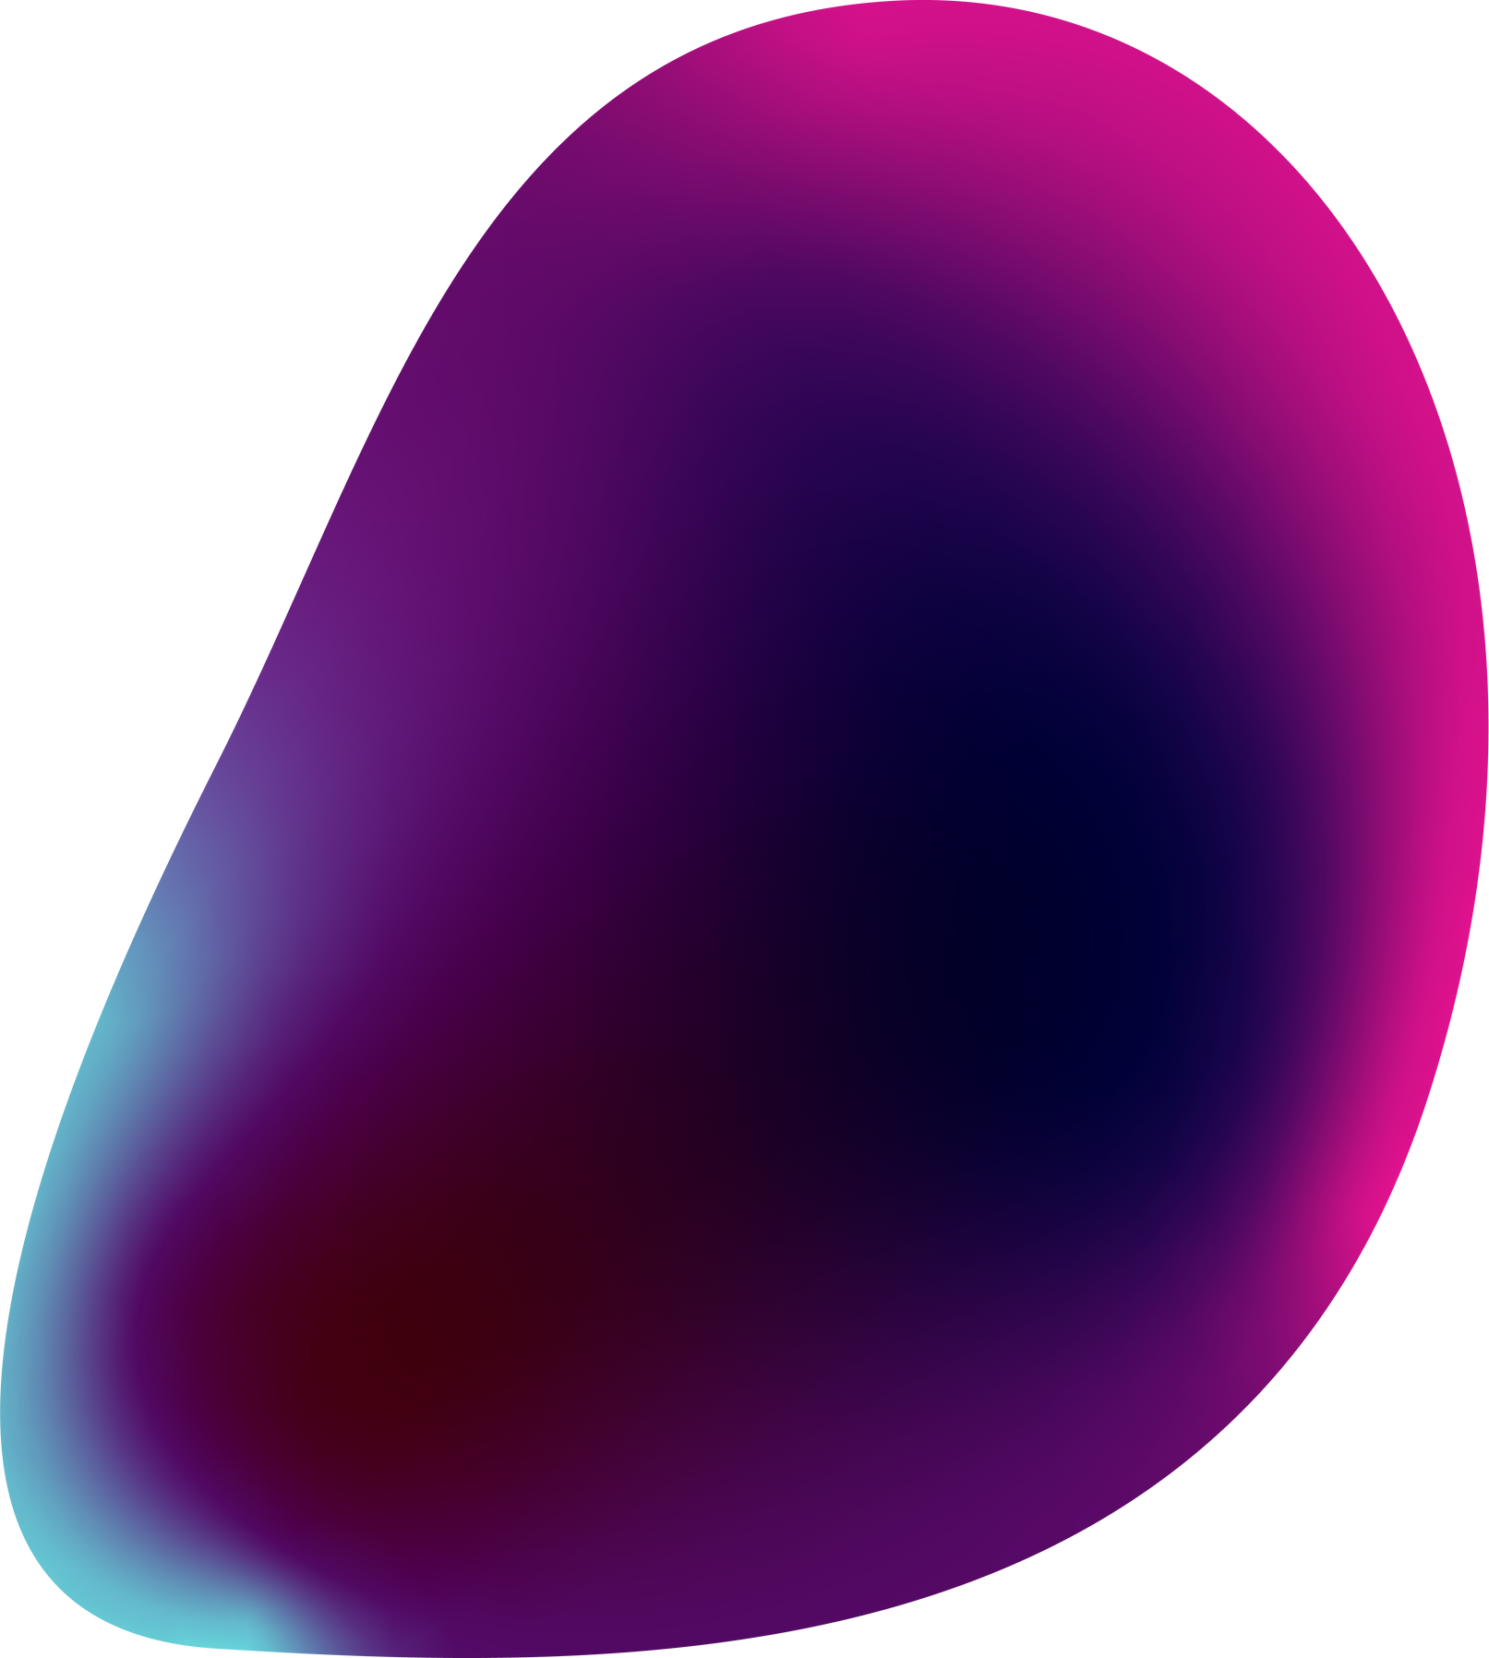

NLP(Natural Language processing)
NLP stands for Natural Language Processing. It is a subfield of artificial intelligence and linguistics that focuses on the interaction between computers and human language. NLP involves developing algorithms and techniques to enable computers to understand, interpret, and generate human language in a way that is meaningful and useful.

Slide 6
Neural Network
A neural network is a computational model inspired by the structure and function of the human brain. It consists of interconnected nodes, called artificial neurons or units, organized into layers. Neural networks are used for various tasks, including pattern recognition, classification, regression, and optimization.

Slide 7
How to make a chatbot in model
Now we are going to build the chatbot using Flask framework but first, let us see the file structure and the type of files we will be creating:
data.json – The data file which has predefined patterns and responses.
trainning.py – In this Python file, we wrote a script to build the model and train our chatbot.
Texts.pkl – This is a pickle file in which we store the words Python object using Nltk that contains a list of our vocabulary.
Labels.pkl – The classes pickle file contains the list of categories(Labels).
model.h5 – This is the trained model that contains information about the model and has weights of the neurons.
app.py – This is the flask Python script in which we implemented web-based GUI for our chatbot. Users can easily interact with the bot.

Slide 8
Training dataset
To train a dataset we do folloing steps and we have following libraries
Importing Libraries:
Downloading NLTK Data:
Initializing Lemmatizer
Loading and Preparing Data
Lemmatizing and Preprocessing Words
Saving Words and Classes
Creating Training Data:
Building the Neural Network Model:
Compiling the Model:
Training the Model

Slide 9
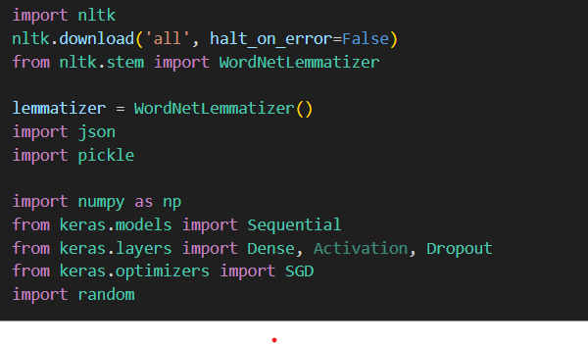
Importing libraries
04

Slide 10
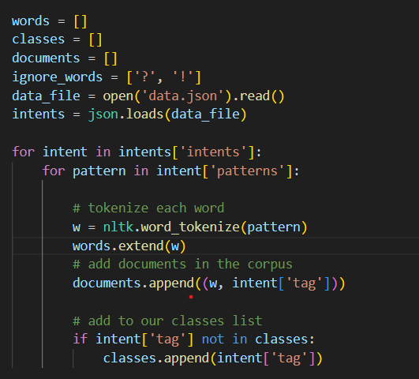
Loading and Preparing Data
04

Slide 11

Lemmatizing and Preprocessing Words
04

Slide 12
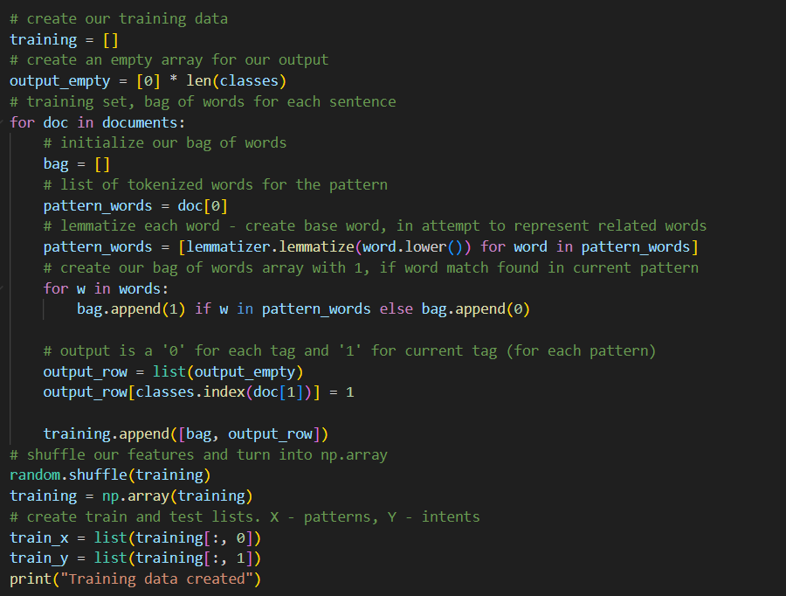
Creating Training Data:
04

Slide 13
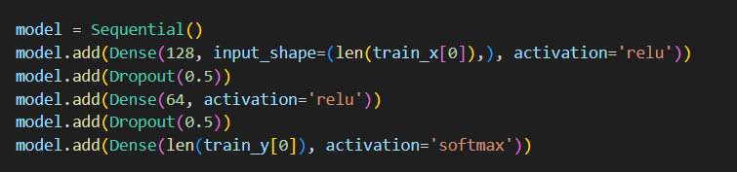
Building the Neural Network Model:
04

Slide 14
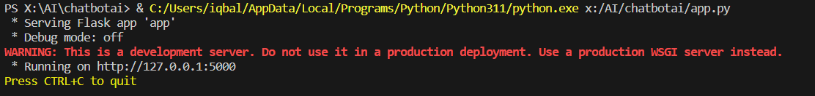
app.py
Overall, this Flask application sets up a web server that provides a chatbot interface. Users can interact with the chatbot by entering text input, and the application will generate appropriate responses using the chatbot_response() function. The interface is rendered using HTML templates, with CSS and JavaScript files stored in the 'static' folder.

Slide 15
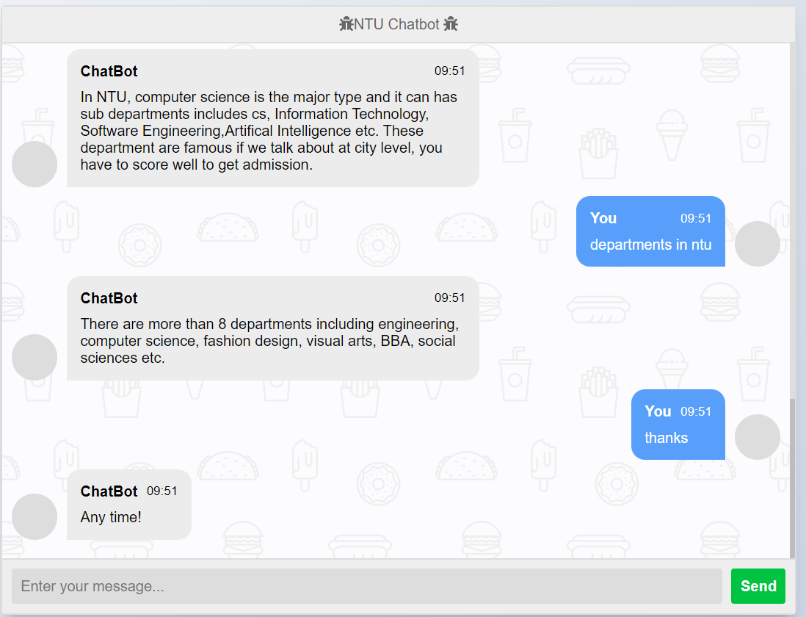
Interface

Slide 16
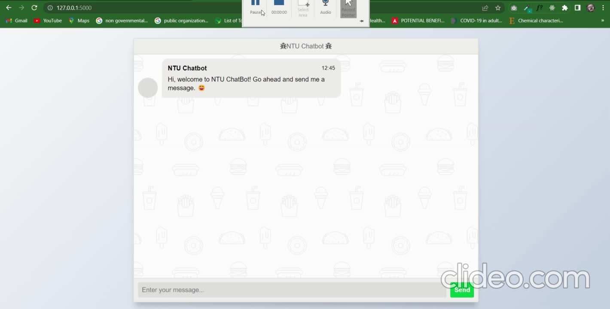

Slide 17
Thank You!

